Slide 1

Pre-Submission Seminar on Student Feedback form
Presented By
Aditya Wadgaonkar
CS19A06
Guided By
Prof. Ratnesh Chaudhary
Department of Computer Science & Engineering
S. B. JAIN INSTITUTE OF TECHNOLOGY MANAGEMENT AND RESEARCH,NAGPUR
An Autonomous Institute, Affiliated to RTMNU, Nagpur

Slide 2
Contents
Problem Statement & Objectives
Introduction
System Design
Developed Modules
Modules Description
Screenshots
Technology Used
Advantages & Applications
Conclusion
Future scope
S. B. Jain Institute of Technology Management and Research
2

Slide 3
Problem Statement & Objectives
Problem Statemen
As we all knew that due to the pandemic covid-19 it has affected each and every day today activity and mainly it has adversely affected the education system diverting the focus of students from studies as there is no physical interaction between teachers and students .
So to overcome the seamless connection online class are continued but to rectify weather the particular subject topic is understand to students or their idea is cleared or not there is not any proper system yet been designed to get an analysis feedback from students.
S. B. Jain Institute of Technology Management and research
3

Slide 4
Objectives
To Provide Advance Search facility to user.
To Reduce affords of user.
To Provide full satisfaction to user.

Slide 5
Introduction
Introduction: Feedback provided during formative assessment guides students to close the gap between their current and desired performance and enhances their learning and satisfaction. To get positive impact of feedback, it should be effective and timely. Perceptions and preferences of students for feedback may vary based on their attitude and many other factors. Teachers may have different perceptions than the students about feedback. So present study tries to introduce feedback in the formative assessment of pharmacology and understand perceptions of students and teachers towards it. Aim: To provide effective, timely feedback to students for giving desired direction to learning and also, to assess students' and teachers' perceptions of feedback.
S. B. Jain Institute of Technology Management and research
5

Slide 6
System Design: Flowchart
Start
First Name
Middle Name
Last Name
Branch
Phone no
Email id
CSE
IT
MECHANICAL
Faculty In-charge
Ratnesh sir
ELECTRICAL
Rupali mam
Feedback
Roshni mam
Pranita mam
Submit
S. B. Jain Institute of Technology Management and research
6

Slide 7
Developed Modules
In this module , we create a feedback form . First we have to write first name , middle name and last name then we have to write email id and phone no .After write all things we have to select branch . While selecting branch we have four branches like CSE , IT , Mechanical and Electrical then select faculty in-charge we have four faculties like Ratnesh sir, Rupali mam, Roshni mam and Pranita mam. Then write some feedback of a particular subject then submit the feedback form using submit button.
S. B. Jain Institute of Technology Management and research
7

Slide 8
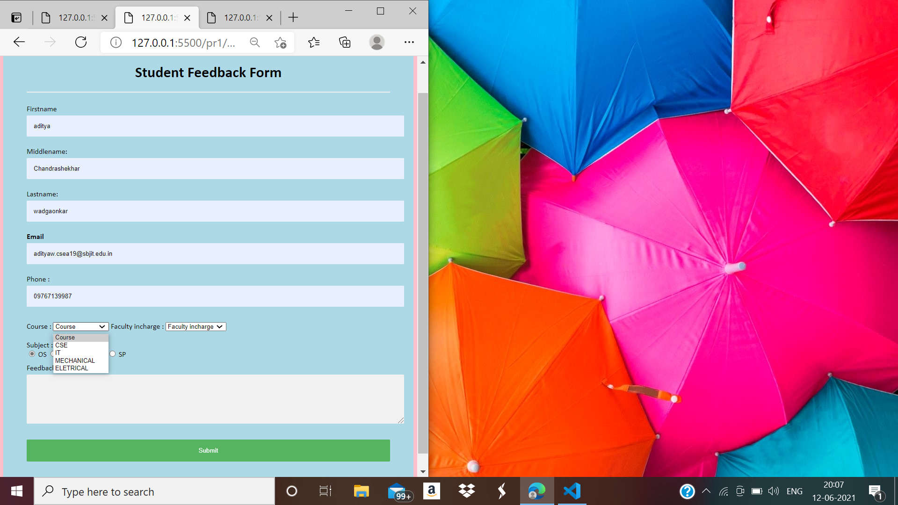
Screen Shots
S. B. Jain Institute of Technology Management and research
8

Slide 9
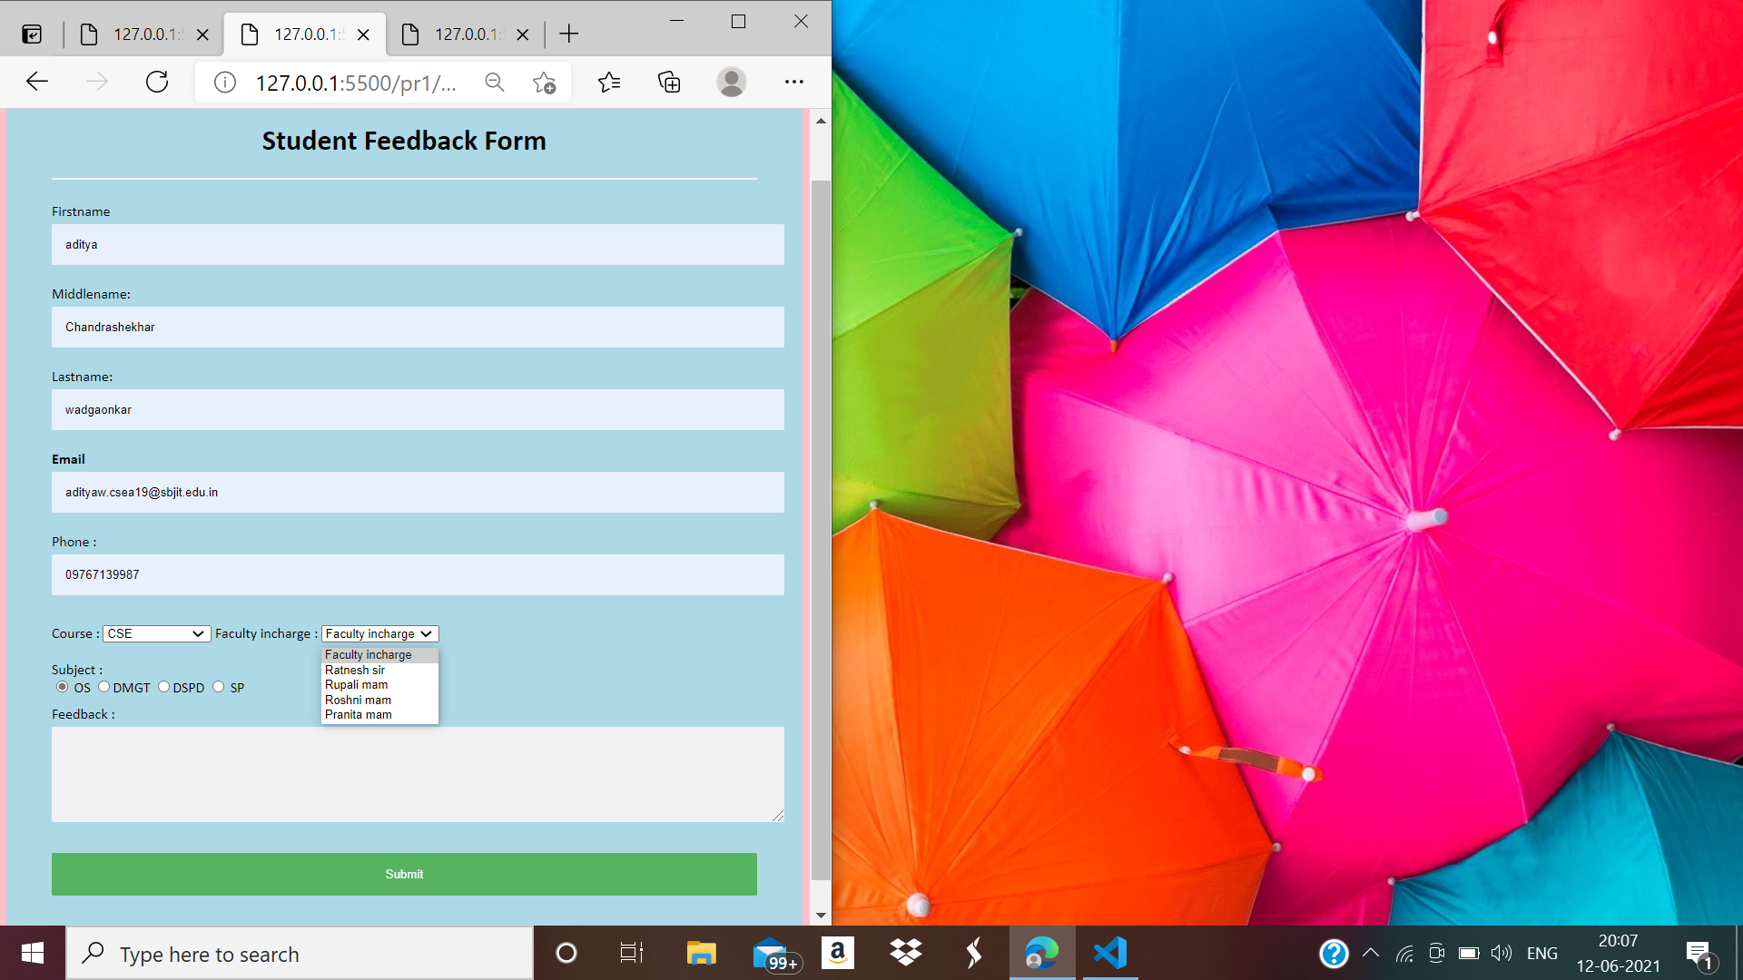
Screen Shots
S. B. Jain Institute of Technology Management and research

Slide 10
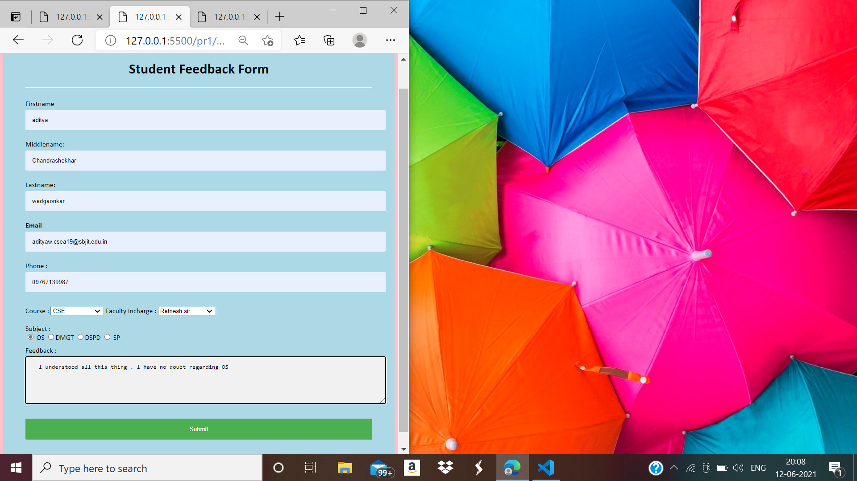
Screen Shots
S. B. Jain Institute of Technology Management and research

Slide 11
Technology Used
Technology : HTML
IDE / Editor : VS code
S. B. Jain Institute of Technology Management and research
11

Slide 12
Advantages & Application
ADVANTAGES
Continuously improve teaching standards with online feedback received. Maximize student participation in courses using feedback and increase overall responses.
Students are invited to fill the survey questionnaire with genuine responses. This puts away all the fears of students at rest by assuring an anonymous feedback system and encouraging them to share their true experience during the course with authentic and accurate results.
using this system reduces the cost of paper and in person surveys which are conducted also the administration cost is reduced.
APPLICATION
Any educational institute can use it.
S. B. Jain Institute of Technology Management and research
12

Slide 13
Conclusion
We have entirely completed our project, and our proposed system is designed to reduce the time and save the efforts of the faculties from maintaining huge amount of records. At the time of the feedback generation it applies the proposed algorithms and methodologies for generating a feedback of a particular batch of students. During the development of the project we understood the importance of individual work while project development and management. While presenting in various seminar we have enhanced our communication skills and displayed professional ethics which will result in lifelong ethics.
S. B. Jain Institute of Technology Management and research
13

Slide 14
Future Scope
FUTURE SCOPE
In future, this is can be applied in sector like school, college or any type of educational institutes, etc. to understand and analyze the feedback of the student for the development of the students and faculty of the institutes.
S. B. Jain Institute of Technology Management and research
14

Slide 15
Thank You!!!

